Slide 1

SMART Compose editor Sagunesh Grover - 100800447 Parth Chotai - 100802846 Roshandeep Singh Saini – 100766638 Aslaf Ahmed Shaikh - 100768232 version 1.0
INSTRUCTOR:
MARCOS BITTENCOURT AIDI 2005

Slide 2
Business IDEA
These days a lot of applications like WordPress, Medium and Blogger are using a text editor in order to write a blog, which is a very traditional way of blogging/documenting ideas.
SMART Compose editor, word predictor app which learns from previous entered text and outputs next word suggestion based on currently inputted text and what it has learned.
Through SMART Compose we intend to make the blogging editors more efficient and faster.
It is an NLP (Natural Language Processing) engine, to predict word and learn the user's writing style according to their niche.

Slide 3
FUNCTIONAL REQUIREMENT
System will suggest next words to the user once they start typing.
User can save what they have typed in a .docx file to their local disk.
System will store every interactions that will be used for future improvement and analytics.

Slide 4



Technology stack
FRONT END
BACK END
DB

Slide 5
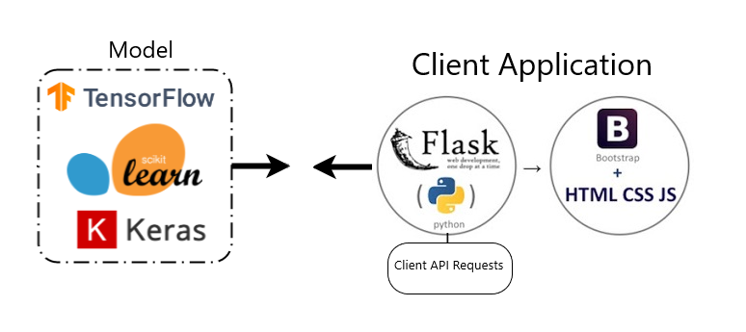
HIGH-LEVEL Application Architecture
DB

Slide 6
Thank you

